Slide 1
IT305 Computer Networks Week 8-Lec 3
IP addressing

Slide 2
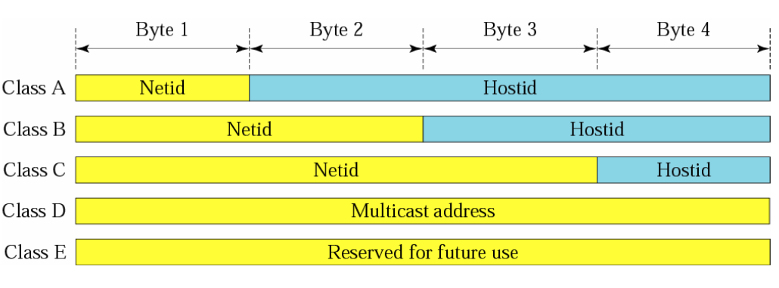
Network and Host IDs

Slide 3
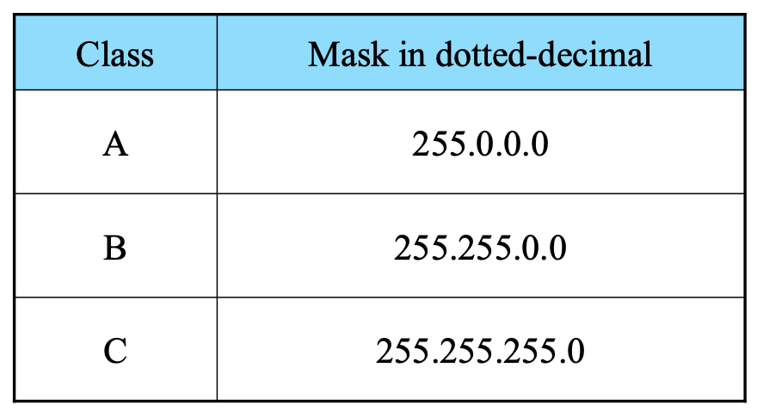
Subnet Mask

Slide 4
Given the address 23.56.7.91 and the default class A mask, find the beginning address (network address).
The default mask is 255.0.0.0, which means that only the first byte is preserved and the other 3 bytes are set to 0s. The network address is 23.0.0.0.
Given the address 132.6.17.85 and the default class B mask, find the beginning address (network address).
The default mask is 255.255.0.0, which means that the first 2 bytes are preserved and the other 2 bytes are set to 0s. The network address is 132.6.0.0.

Slide 5
Methods of allocating addresses?
Classful
Fixed Length Subnet Mask (FLSM)
Variable Length Subnet Mask(VLSM)

Slide 6
Subnetting Types
There are three types of subnetting examples :
1) Subnetting when given a required number of networks
2) Subnetting when given a required number of clients
3) Given an IP address & Subnet Mask, finding original network range

Slide 7
You have a Class C network, and you need ten subnets. Each subnet should get as many number of addresses for hosts as possible. How would you break the network ? What is the new subnet mask?
Solution steps:
How many subnets required?
How many bits can I modify?
How many bits can I retain for hosts and give away for subnets?
2^{x} = 10
Closest but highest value – 4.
2⁴=16 networks possible
16> 10 , no other number close to 10
If 4 bits have to be given , retain remaining 4 bits starting from Right most bit to left in the default subnet mask
255.255.255.0 = 1 1 1 1 1 1 1 1. 1 1 1 1 1 1 1 1 .1 1 1 1 1 1 1 1. 0 0 0 0 0 0 0 0
= 1 1 1 1 1 1 1 1. 1 1 1 1 1 1 1 1 .1 1 1 1 1 1 1 1. 1 1 1 1 0 0 0 0
New subnet?
16 subnets, each subnet accommodates 16 hosts.

Slide 8
You have a Class C network, and you need ten subnets. Each subnet should get as many number of addresses for hosts as possible. How would you break the network ? What is the new subnet mask?
Solution steps:
How many subnets required? 10
How many bits can I modify? 8 bits since it is class C
How many bits can I retain for hosts and give away for subnets?
2^{x} = 10
Closest but highest value – 4.
2⁴=16 networks possible
16> 10 , no other number close to 10
If 4 bits have to be given , retain remaining 4 bits starting from Right most bit to left in the default subnet mask
255.255.255.0 = 1 1 1 1 1 1 1 1. 1 1 1 1 1 1 1 1 .1 1 1 1 1 1 1 1. 0 0 0 0 0 0 0 0
= 1 1 1 1 1 1 1 1. 1 1 1 1 1 1 1 1 .1 1 1 1 1 1 1 1. 1 1 1 1 0 0 0 0
New subnet mask = 255.255.255.240
16 subnets, each subnet accommodates 16 hosts.

Slide 9
Requirement
if host, then
{
step 1:2^{x}=num_{Hosts}
step 2: 0s to 1s and compute new subnet mask
step 3: getting separate subnets
Compute →. 2(^{last possible network bit)}
step 4: Allot IP addresses
}
This will tell us how many bits to retain(R2L) and how many to convert to 1's
This will get us the desired number of hosts with
fixed number of subnets.
This will give you the range for each subnet
first and last cannot be : first is subnet addr, last is broadcast addrs for that subnet. 2nd-lastbutone are usable host addresses.

Slide 10
Requirement
if nwk, then
{
step 1:2^{x}=num_{Nwks}
step 2: 0s to 1s and compute new subnet mask
step 3: getting separate subnets
Compute →. 2(^{last possible network bit)}
step 4: Allott IP addresses
}
This will tell us how many bits to give 0s to 1s (L2R) and how many to retain

Slide 11
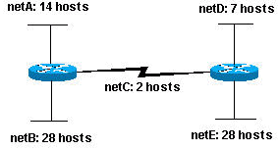
Questions
A service provider has given you the Class C network range 209.50.1.0. Your company must break the network into 20 separate subnets.
A service provider has given you the Class C network range 209.50.1.0. Your company must break the network into as many subnets as possible as long as there are at least 50 clients per network.
A service provider has given you the Class C network range 209.50.1.0. Your company must break the network as shown below

